Slide 1

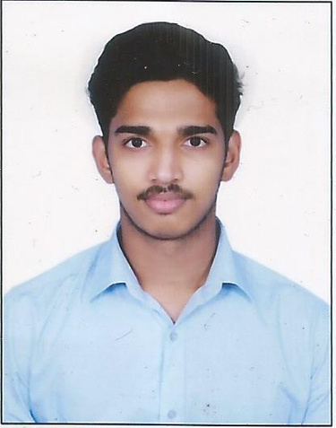
Name:-
Abhijith S R
SkillsBuild Email ID:-
abhijithsr22@gmail.com
College Name:-
Joginpally B R Engineering
College
College State:-
Telangana
Internship domain,
start and end date:-
Front-End Development,
24.6.2024 -31.7.2024

Slide 2

Medical Hospital Website with Integrated Chatbot
The project aims to develop a modern, user-friendly medical hospital website that provides essential healthcare services and information to patients, doctors, administrative staff, and visitors. The website is enhanced with an integrated chatbot to assist users with their queries and tasks, thereby improving user engagement and operational efficiency. This website is a cloned website of a medical hospital’s website.

Slide 3
Agenda
Project Overview
Modeling and Frameworks Used
End Users
Solution and Value Proposition
Customizations and Unique Features

Slide 4
Project Overview
Objective: To create a comprehensive medical hospital website that provides users with essential healthcare services and information.
Features: Information about hospital services, doctor profiles, appointment scheduling, patient records, and a chatbot for instant assistance.
Technology: Built using modern web technologies for a seamless user experience.

Slide 5
End Users
Patients: Looking for medical information, booking appointments, and accessing their health records.
Visitors: Seeking information about the hospital’s facilities, services, and specialists.
Doctors and Medical Staff: Managing appointments, patient records, and providing online consultations.
Administrative Staff: Overseeing the hospital’s operations, scheduling, and patient management.

Slide 6
Solution and Value Proposition
Integrated Chatbot: Provides instant assistance to users, answering queries, helping with appointment bookings, and guiding them through the website.
Enhanced User Experience: Streamlined navigation, easy access to information, and quick interaction with hospital services.
Operational Efficiency: Simplified management for hospital staff through digital records and scheduling.
Patient Engagement: Improved patient satisfaction with quick responses and easy access to healthcare services.

Slide 7
Customizations and Unique Features
Added Chatbot: Custom-developed chatbot to assist users with common queries and tasks, enhancing user engagement and support.
AI-Powered Assistance: The chatbot is designed to handle common queries, provide guidance, and assist users with tasks such as booking appointments and accessing information.
24/7 Availability: Unlike human staff, the chatbot is available round-the-clock to assist users at any time, improving accessibility and user satisfaction
Patients: Looking for medical information, booking appointments, and accessing their health records.

Slide 8
Modeling and Frameworks Used
Frontend:-
HTML (HyperText Markup Language):
Purpose: The backbone of the website’s structure, used to create the layout and content.
Customization: Custom HTML elements are used to create unique layouts for different pages, ensuring that the design aligns with the hospital’s branding.
CSS (Cascading Style Sheets):
Purpose: Styling the website to enhance its visual appeal.
Customization: Utilized custom CSS to ensure a consistent design theme, including color schemes, fonts, and spacing. CSS frameworks like Bootstrap may have been used for responsive design, ensuring the site looks good on all devices.
JavaScript:
Purpose: Adding interactivity to the website.
Customization: Used for dynamic content updates, form validations, and interactive elements like carousels and modals. Libraries like jQuery or frameworks like React.js or Vue.js could be used to simplify and enhance JavaScript development.

Slide 9
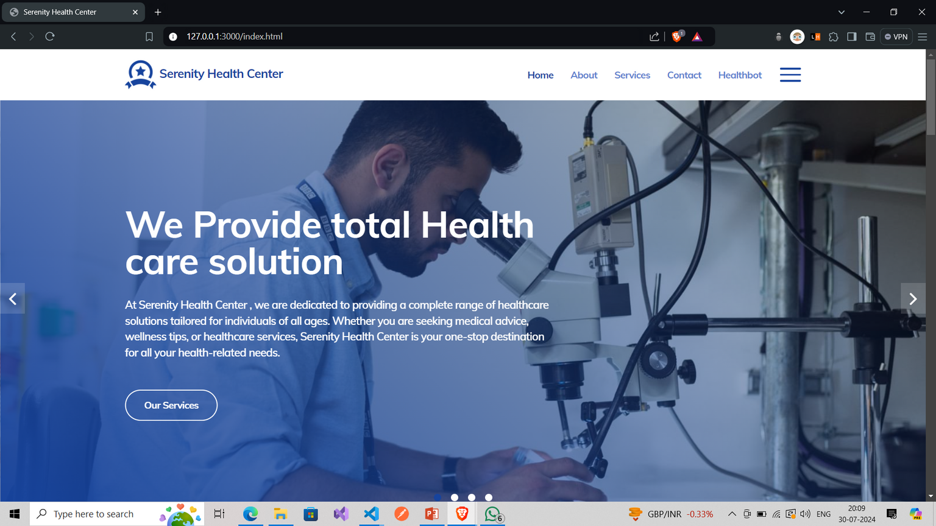
RESULT

Slide 10
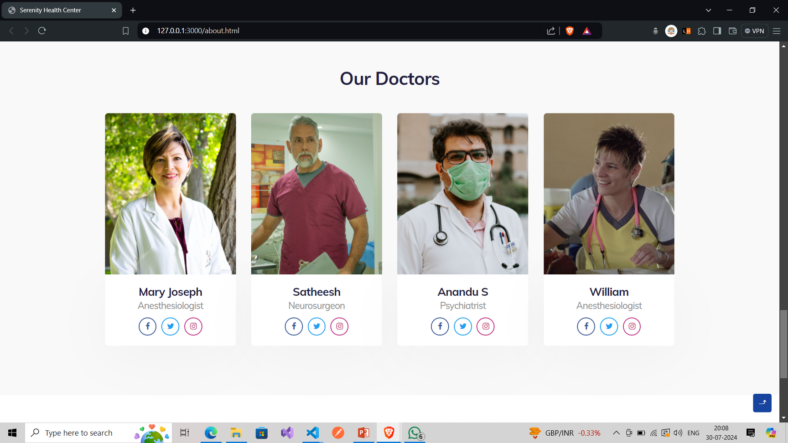

Slide 11
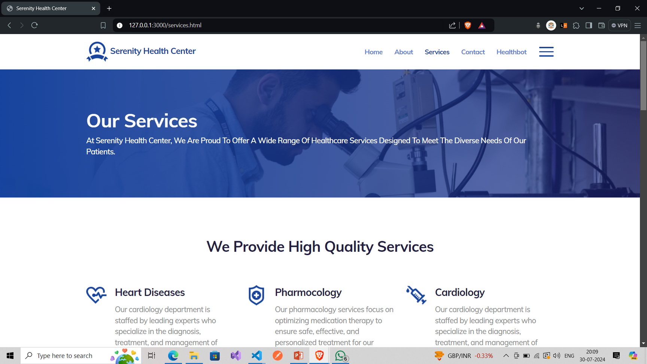

Slide 12
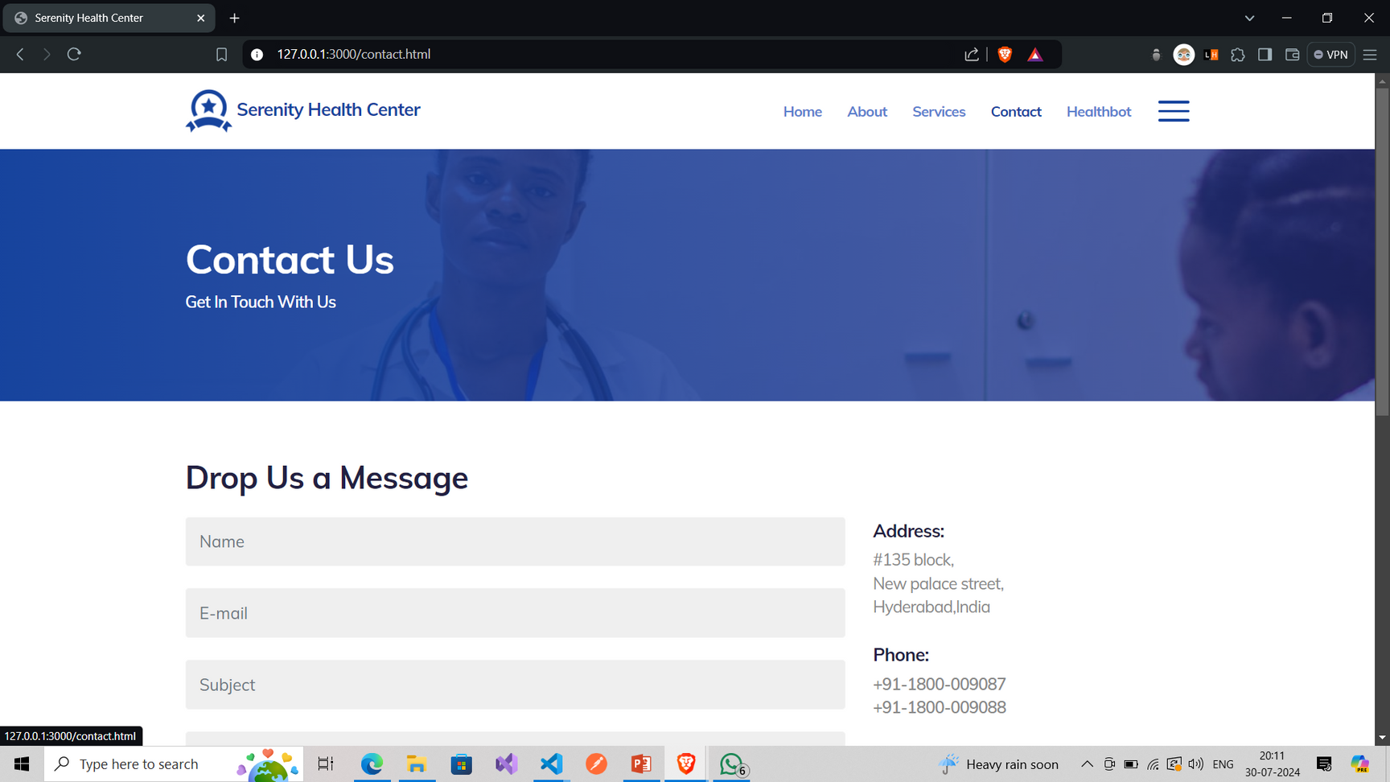

Slide 13
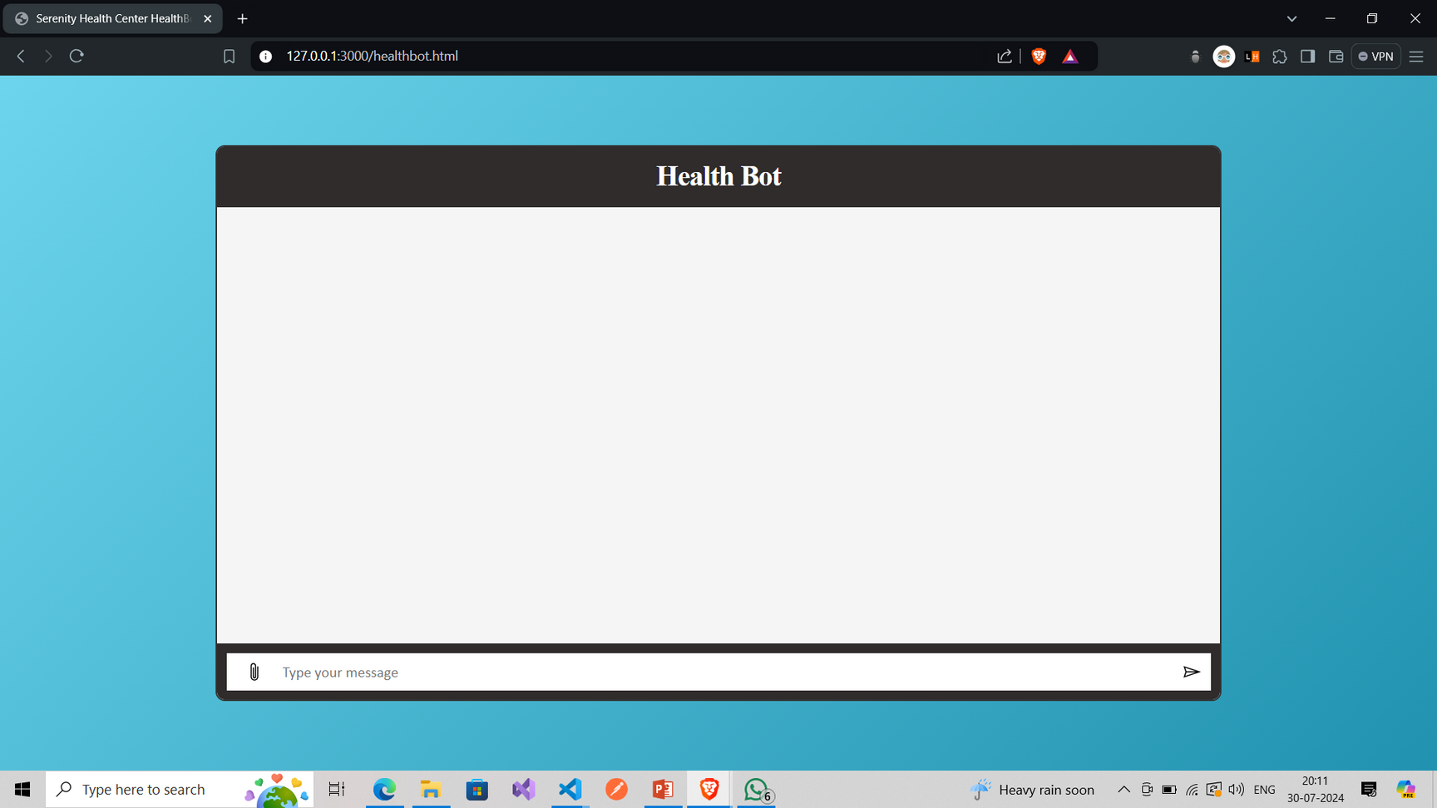

Slide 14
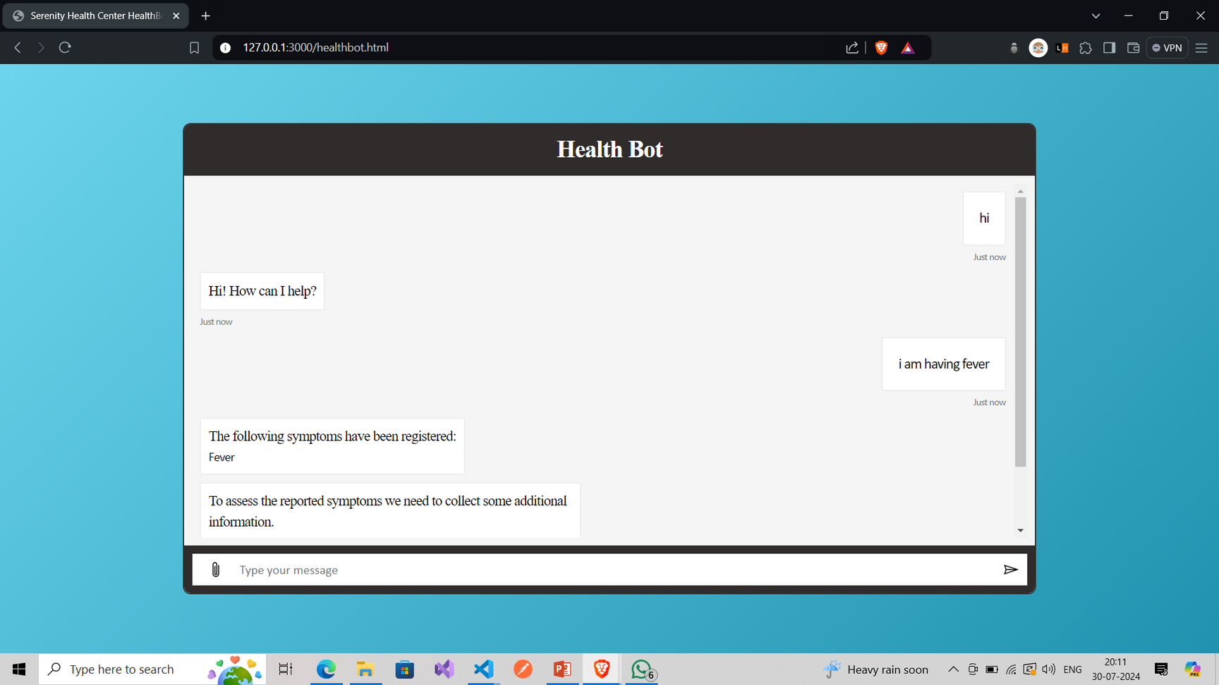

Slide 15
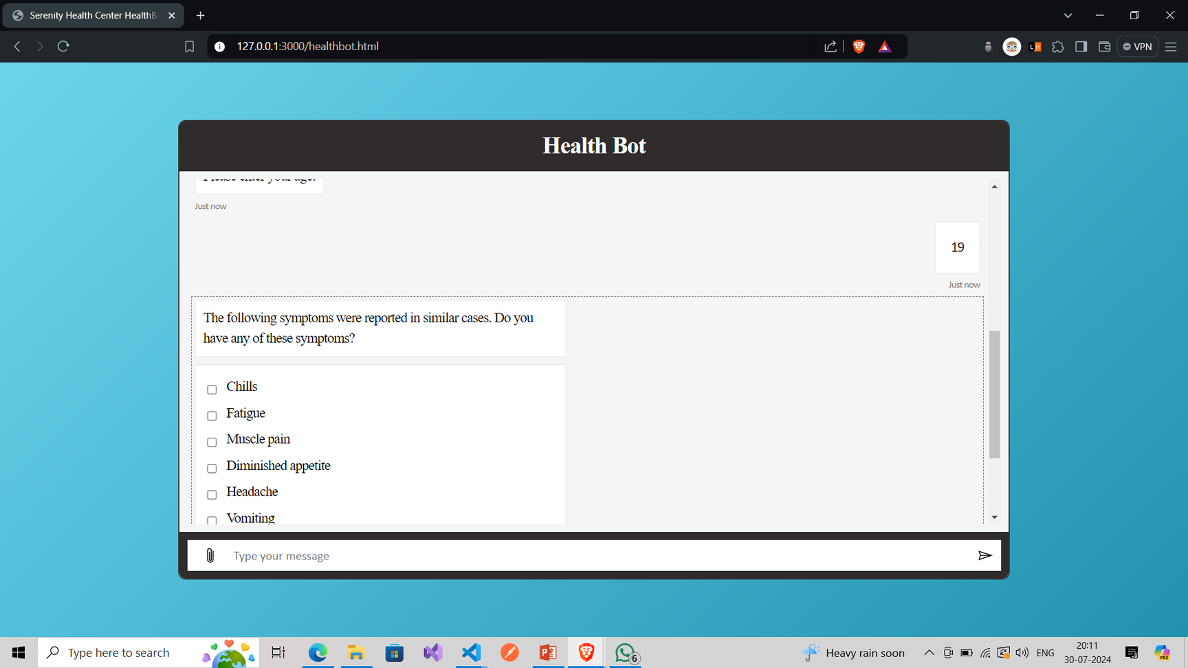

Slide 16
Links
Github:-
https://github.com/Abhijithsr13/Edunet_foundation
Live :-
https://abhijithsr13.github.io/Edunet_foundation/
Github profile link :-
https://github.com/Abhijithsr13

Slide 17

THANK
YOU

